Slide 1
Fake Product review Monitoring and Removal System
Project Guide:
Ms.Vithya (M.E , Associate Professor)
Team Members
1.) ArunPrakash(Lead) (111619104301) 2.)UgeshKumar (111619104157) 3.)Sugathithyan (111619104147) 4.)Rishon (111619104120)

Slide 2
Abstract
Fake review detection and its elimination from the given dataset using different Natural Language Processing (NLP) techniques is important in several aspects. In this article, the fake review dataset is trained by applying two different Machine Learning (ML) models to predict the accuracy of how genuine are the reviews in a given dataset. The rate of fake reviews in Ecommerce industry and even other platforms is increasing when depend on product reviews for the item found online on different websites and applications.
The products of the company were trusted before making a purchase. So this fake review problem must be addressed so that these large E-commerce industries such as Flipkart, Amazon, etc. can rectify this issue so that the fake reviewers and spammers are eliminated to prevent users from losing trust on online shopping platforms.
This model can be used by websites and applications with few thousands of users where it can predict the authenticity of the review based on which the website owners can take necessary action towards them. This model is developed using Naïve Bayes and random forest methods. By applying these models one can know the number of spam reviews on a website or application instantly. To counter such spammers, a sophisticated model is required in which a need to be trained on millions of reviews. In this work ”amazon Yelp dataset” is used to train the models and its very small dataset is used for training on a very small scale and can be scaled to get high accuracy and flexibility.

Slide 3
Introduction
The elegance with online review posting has grown at a faster rate and people buying almost everything online that gets delivered at their doorsteps. Hence, people are not subject to physically inspect the product when buying online so they drastically unwantedly/wontedly depend on reviews of other buyers this must be made truthful as much as possible so that the buyer is not cheated with fake reviewers or spammers time and again. The problem is simple yet tiring to be accomplished through/read every review to mark it as a fake or ambiguous category this must be done systematically to get to the root of the problem
The interesting thing is spammers who didn't use the product can be caught this way. A spam review or the usage of different customer id can be used to filter review of the product falsely to get a good rating of the product. This can be filtered by checking the use of words like "awesome", "so good", "fantastic" etc. can be flagged. Since they tend to hype the product or they try t o emulate genuine reviews with the same words using it again and again to make an impact on the buyer. Hence the issue of spam filtering requires huge data to train and be effective with added domain knowledge such as sarcasm sentences used by users to show their dissent towards the product, sometimes the product is good but not the delivery or the packing which affects the review classification. Here, an NLP technique is used to identify such reviews instead of misclassification to a negative review as in sentiment analysis. To remove unwanted or outdated product reviews those include data pre-processing.

Slide 4
Introduction
The focus of this research is to create an environment of online E-commerce industry where consumers build trust in a platform where the products they purchase are genuine and feedbacks posted on these websites/applications are true, are checked regularly by the company where the number of users is increasing day by day, henceforth companies like Twitter, WhatsApp, Facebook use sentiment analysis to check fake news, harmful/derogatory posts and banning such users/organizations form using their platforms. Parallel to that E-commerce (Flipkart, Amazon) industries, hotels booking (Trivago), logistics, tourism (Trip Advisor), job search (LinkedIn, Glass door), food (Swiggy, Zomato), etc. use algorithms to tackle fake reviews, spammers to deceive the consumers in buying below average products/ services. And the users need to be alerted of the spammer like “not verified profile” hence users need not worry about such false users. Manual labelling of the reviews is practically time-consuming and less effective. So supervised learning model is used for labelling the reviews and then predicting the label is not feasible.

Slide 5
Dataset
Dataset used is “amazon academic review” which contains reviews, useful votes, ratings, user id, and many other attributes. The useful parameters are retrieved for feature engineering. The dataset contains thousands of original and fake reviews mixed to easily assess the accuracy of the model being implemented using this dataset. The Yelp dataset released for the academic challenge contains information for 11,537 businesses. This dataset has 8,282 check-in sets, 43,873 users, 229,907 reviews for these businesses (www.yelp.com/dataset). The dataset is challenging since it contains a large set of varied reviews and parameters for training any algorithm.

Slide 6
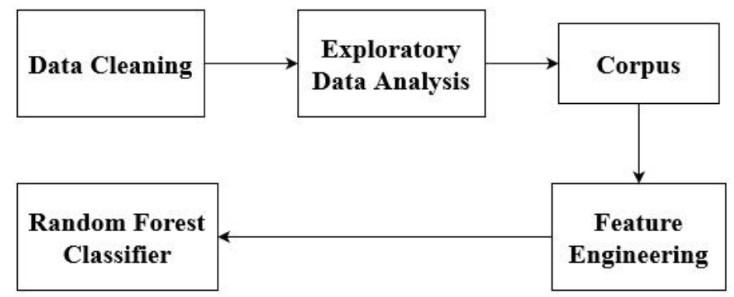
PROPOSED METHODOLOGY

Slide 7
Model diagram for fake review detection

Slide 8
Data Cleaning Block Diagram
For this step we need to follow various sub steps to get our data clean. First, we read the entire data from the csv/xlsx file. Assign the extracted data to the dataframe. Create Boolean values (true or false) of the dataframe, depending on the resultant Boolean value further steps to be followed. Using heatmap function check for all the null values in the dataframe. Extract all the required data and complete all the modifications to be done. Finally, the data is cleaned.

Slide 9
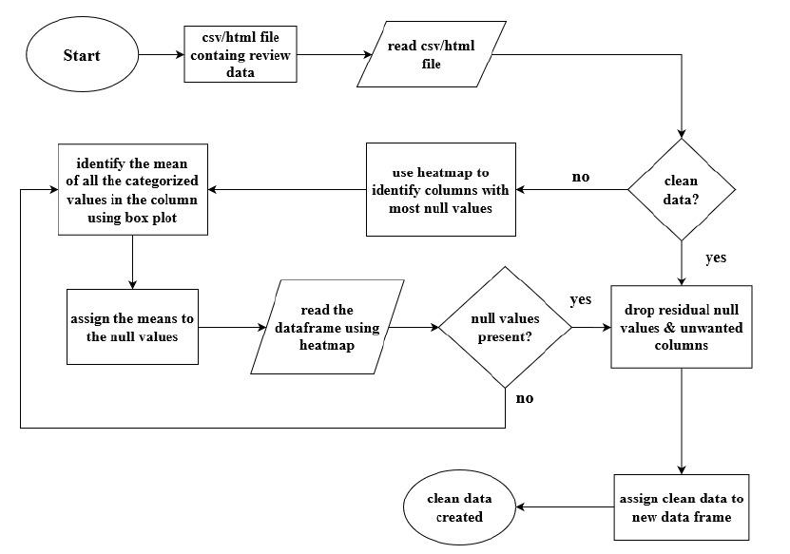
Flow chat - Data Cleaning

Slide 10
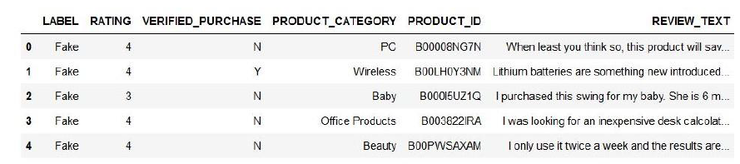
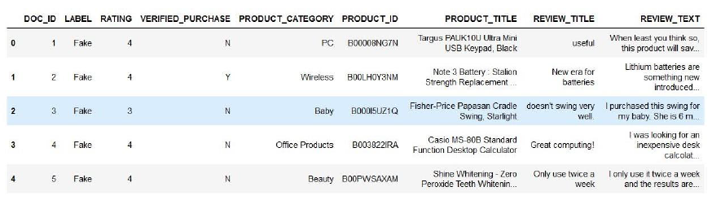
Data Cleaning

Slide 11
EXPLORATORY DATA ANALYSIS
Exploratory Data Analysis (EDA) is method of analyzing datasets. It helps in summing up the overall view of the entire dataset, often with visual representation. This is a technique commonly used by analysts to convey their findings in a clearly understandable format. EDA is commonly done with the help of plots and there are several plots to choose from for unique requirements. Boxplot, Histogram, Scatterplot and Box and Whiskers plot are some of the common types are plots that we use.

Slide 12
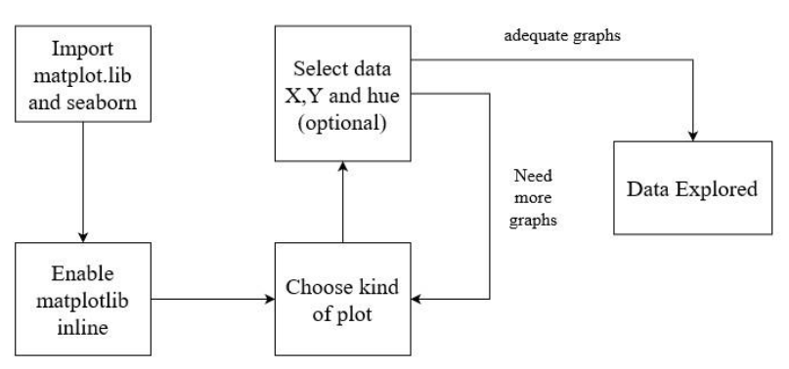
Exploratory Data Analysis

Slide 13
Exploratory Data Analysis
For any program to run successfully we need to get access from some of the header files which have inbuilt functions on which we can perform various operations. We import two files which are
● Matplotlib - a plotting library.
● Seaborn - data visualization library based on matplotlib
We enable matplotlib inline function and choose the type of plot required for our module. We select data X, data Y and hue as an optional plot. Make the graphs and look for satisfactory plots and the data will be explored. If more graphs are required then choose the plot again and make adequate graphs.

Slide 14
CORPUS
Corpus in general is considered as a sentence whose punctuations, stop words, prefixes as well as suffixes are removed. This method is usually done when dealing with Natural Language Processing which uses the bag of words model. The main purpose of making a Corpus is the make the machine learning model more efficient courtesy of the removal of unwanted words and characters.
First, we read a string as an input in the corpus. We remove all the punctuations present in the string. We remove all the stopwords (words which are not necessary and don’t make any difference with or without). Tokenization - very important step in this where we replace the words with a unique identification such as a number to words. We perform stemming of all words mapping them to their root. We join all the leftover words which are essential for the corpus sentence.

Slide 15
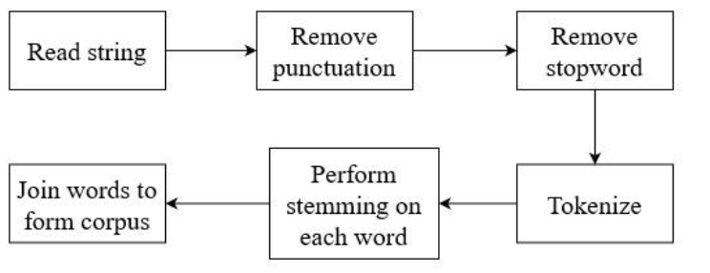
CORPUS

Slide 16
CORPUS
TOKENIZATION
The first basic step in preprocessing data before feeding it into our system is Tokenization. This step is followed in every text classification engine as it helps in reducing the processing time when we train the data. Tokenization involves breaking down of character into individual words called tokens and removing punctuations.
Example for Tokenization:
Input Text: 'A group of top ranked anime villains combined is called Espada.'
Output test: ['A','group','of','top','ranked','anime','villians','combined','is','called','Espada']
This process can now be easily performed in Python by using the .split() function. The next step of Tokenization is Stop-Word Elimination.

Slide 17
CORPUS
STOP-WORD ELIMINATION
Once the characters are broken down into tokens, the next step is Stop-Word Elimination. In this step, all the negative stop words including pronouns, conjunctions and prepositions in the sentence are removed. This is done to reduce the number of words in the text fed into the system without affecting the overall meaning of the sentence, thus in turn reducing the time required for processing when training the data.
Example for Stop-Word Elimination:
Input Text: ['A','group','of','top','ranked','anime','villians','combined','is','called','Espada']
Output Text: ['group','top','ranked','anime','villains','combined','Espada']
Stop-words are removed with the help of 'stopwords' package from nltk.corpus in Python. This package consists of the set of stopwords which if present in the sentence are removed.

Slide 18
CORPUS
STEMMING
Stemming is the process of reducing a word to its root by removing ant prefixes and suffixes in the word. For instance, let us take three words ‘study’, ‘studying’ and ‘studied’, we humans know that these three words have the same meaning but that is not the case with machine. For them these three words have different meaning, so in order to prevent this stemming is done. Stemming converts these three words into ‘studi’ so that the computer can take them as one word

Slide 19
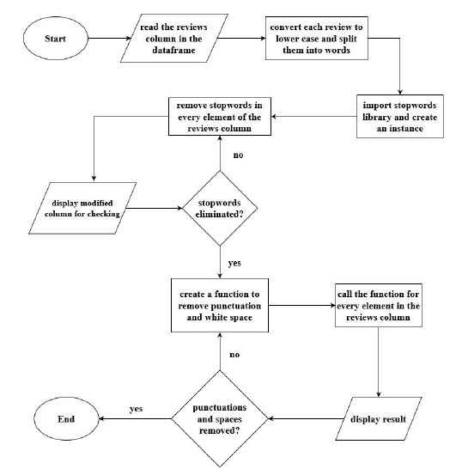
Flow Chat - Tokenization and Stop-word elimination

Slide 20
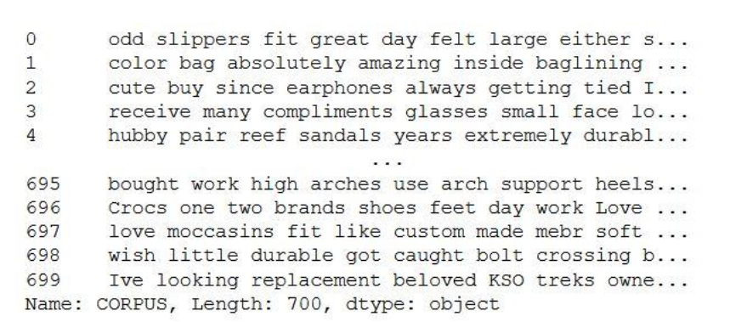
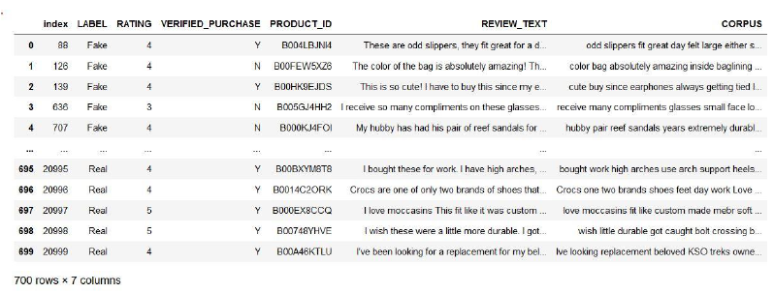
Corpus

Slide 21
FEATURE ENGINEERING
Feature engineering is the extraction of data and converting them in a format where the machine learning model can understand. In Layman terms, it is the conversion of all the string values into numbers.
In this we carry forward with the corpus sentence. We use the count vectorize function to form a bag of words model. In this model, we extract words which are essential and give them the count depending on the number of times they have appeared. We assign these words to the dataframe. Following this, we create dummy variables of the categorical data where we make categories of different words and append them to the dataframe. Now the final dataset has been created and ready for implementation.

Slide 22
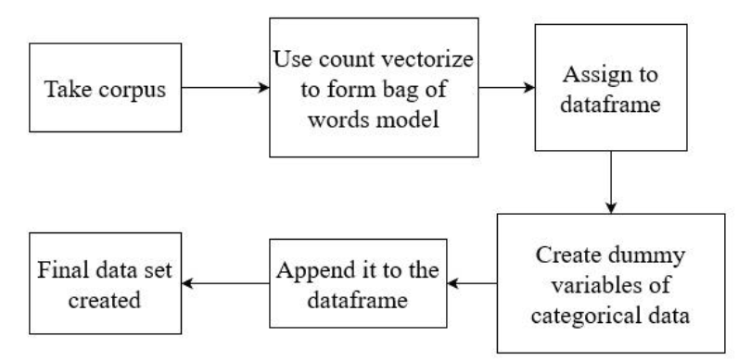
FEATURE ENGINEERING

Slide 23
FEATURE ENGINEERING
BAG OF WORDS MODEL
Now that the stop-words are removed, the next step is called the Bag-of-Words Model, or the BoW Model. Until now, beginning from the text being very messy, tokenization was done to break them down and then the negative stop-words were then removed. Now, the BoW model involves calculating the sentence wise frequency of the words present in the whole dataframe. This is like giving a subjectivity score to the text data. That is, a word is a feature in the ML standpoint.
Bag-of-Words is implemented using the concept of sentence_vectors with the help of the nltk package in Python.
Example for Bag-of-Words Model:
['group' = 1,'top' = 1,'ranked' = 0,'anime' = 1,'villians' = 1,'combined' = 0,'Espada' = 1]
"group anime combined" = [1, 1, 0, 1, 0, 1, 1]
"top ranked combined" = [1, 0, 0, 1, 1, 1, 1]
Since the output data is in the form of Boolean values, the processing time and complexity during training of data is very much lower when in comparison to when the output data is in the form of text or string.

Slide 24
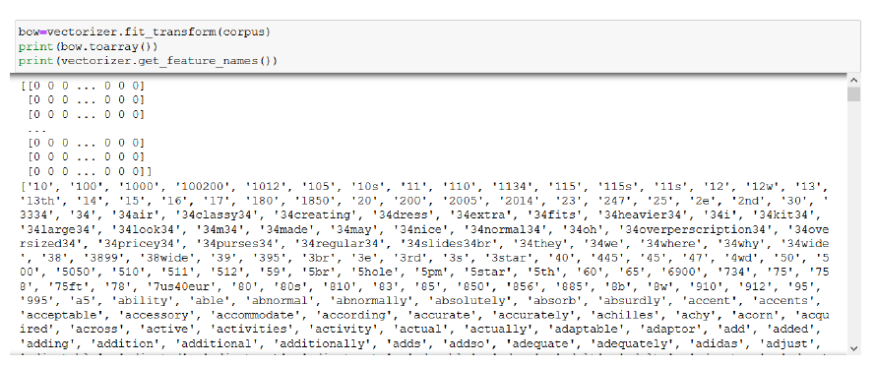
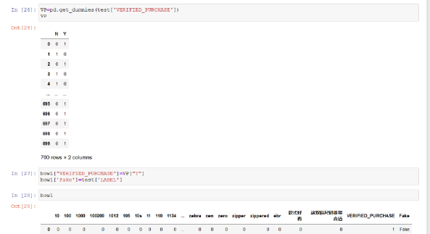
FEATURE ENGINEERING

Slide 25
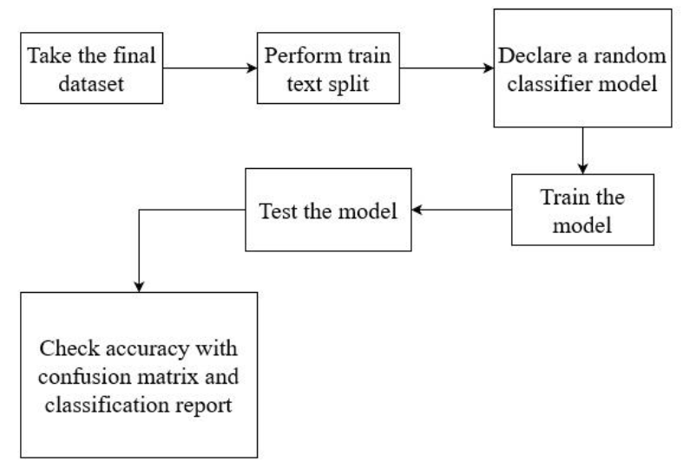
Random Forest Classifier

Slide 26
Random Forest Classifier
Random Forest Classifier is an ensemble of several independent decision tress that work together to make the predictions required. This is an upgraded version of the normal decision tree model. Each decision tree gives a prediction and the prediction with the highest number will become our final prediction value. Thus, making the required prediction. This is the most efficient way to do binary classification.
Having the final dataset, using the train text split function we split the words from the sentences and declare a random classifier model. We train the model depending on our specifications and then test the final model. We check accuracy which defines our model using a confusion matrix and classification report.

Slide 27
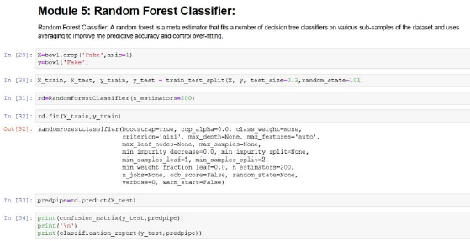
Random Forest Classifier
This Module is of splitting the input data X and target labels y into training and testing sets with a 70-30 split ratio, respectively.
The confusion matrix function shows the number of true positive, false positive, true negative, and false negative predictions

Slide 28
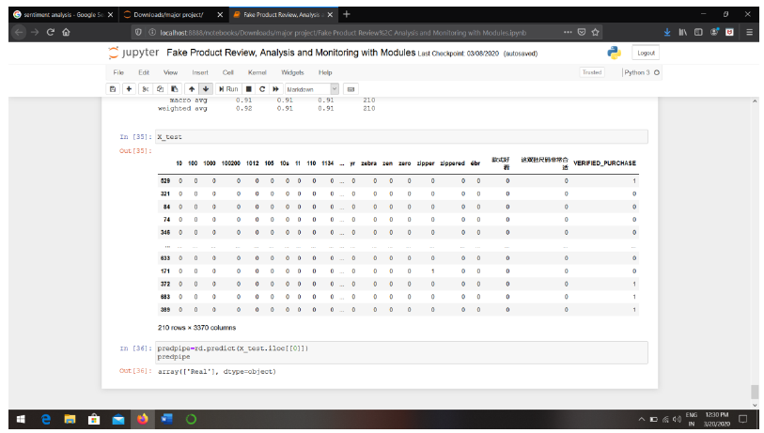
Random Forest Classifier

Slide 29
Existing systems:
The previous analysis is done on the expressed views through text, blogs, reviews, feedbacks, etc. as opinions by users which are unique to compute, study to obtain relevant information, that is nothing but sentiment analysis.
Exiting research used a two-step approach, SVM classifier for classifying tweets other used emoticons, smileys, and Hashtags to classify labels into multiple sentiments. The other researcher used an SVM classifier for training data using emoticons. Lexicon-based methods: - Based on counting the number of positive and negative words in a sentence- Twitter. Rule-based methods: – Based on syntactic rules, e.g., [query] is pos-adj – Tweet feel Machine learning based methods: – Based on the classifier built on a training data Twitter sentiment.

Slide 30
Proposed System
In this work, the comparison of two models developed to justify the model performance for this “Amazon’s yelp” dataset and their relevance to deploy these models in real-time software. The Random Forests (RF) model performed well compared to the Naïve Bayes algorithm by a large margin in the fake review data analysis. The fake review detection problem is addressed fairly and gives a fair insight into its legality and need. The purpose is to select a suitable algorithm to fulfill the task of fake review detection and its elimination.

Slide 31
System Requirements
HARDWARE REQUIREMENTS
Processor - Intel Pentium Dual Core
Speed - 3.0 Ghz
RAM - 4 GB
Hard Disk - 500 GB
Key Board - Standard Windows Keyboard
Mouse - Optical Mouse
Monitor - LED Monitor
SOFTWARE REQUIREMENTS
Operating system : Windows 8.1
Coding Language : Python 3.2
Tool : Anaconda 3

